Slide 1
Data Mining ~ ~ Meet 03 ~ ~ Program Studi Sains Data Universitas Teknologi Yogyakarta
Dr. Donny Avianto, S.T., M.T.

Slide 2
Data Preprocessing Bag. I

Slide 3
Data Preprocessing
Why preprocess the data?
Data cleaning
Data integration and transformation
Data reduction
Discretization and concept hierarchy generation

Slide 4
Why Data Preprocessing?
Data in the real world is dirty
incomplete: lacking attribute values, lacking certain attributes of interest, or containing only aggregate data
noisy: containing errors or outliers
inconsistent: containing discrepancies in codes or names
No quality data, no quality mining results!
Quality decisions must be based on quality data
Data warehouse needs consistent integration of quality data
Required for both OLAP and Data Mining!

Slide 5
Why can Data be Incomplete?
Attributes of interest are not available (e.g., customer information for sales transaction data)
Data were not considered important at the time of transactions, so they were not recorded!
Data not recorder because of misunderstanding or malfunctions
Data may have been recorded and later deleted!
Missing/unknown values for some data

Slide 6
Why can Data be Noisy/Inconsistent?
Faulty instruments for data collection
Human or computer errors
Errors in data transmission
Technology limitations (e.g., sensor data come at a faster rate than they can be processed)
Inconsistencies in naming conventions or data codes (e.g., 2/5/2002 could be 2 May 2002 or 5 Feb 2002)
Duplicate tuples, which were received twice should also be removed

Slide 7
Major Tasks in Data Preprocessing
Data cleaning
Fill in missing values, smooth noisy data, identify or remove outliers, and resolve inconsistencies
Data integration
Integration of multiple databases, data cubes, or files
Data transformation
Normalization and aggregation
Data reduction
Obtains reduced representation in volume but produces the same or similar analytical results
Data discretization
Part of data reduction but with particular importance, especially for numerical data

Slide 8
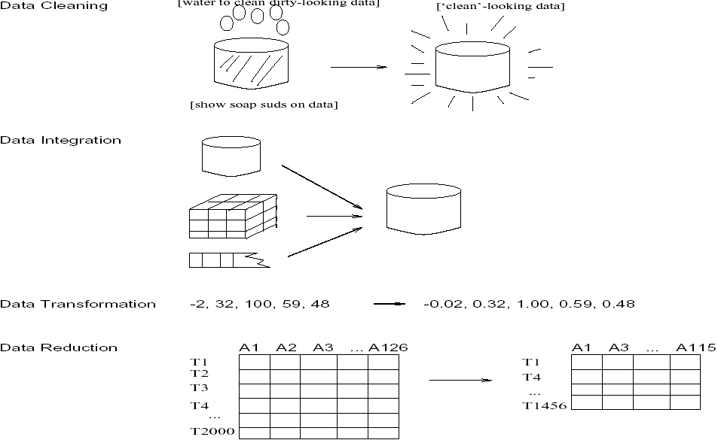
Forms of data preprocessing

Slide 9
Data Cleaning
Data cleaning tasks
Fill in missing values
Identify outliers and smooth out noisy data
Correct inconsistent data
Other data problems which requires data cleaning
duplicate records

Slide 10
How to Handle Missing Data?
Ignore the tuple: usually done when class label is missing (assuming the tasks in classification)—not effective when the percentage of missing values per attribute varies considerably.
Fill in the missing value manually: tedious + infeasible?
Use a global constant to fill in the missing value: e.g., “unknown”, a new class?!
Use the attribute mean to fill in the missing value
Use the attribute mean for all samples belonging to the same class to fill in the missing value: smarter
Use the most probable value to fill in the missing value: inference-based such as Bayesian formula or decision tree

Slide 11
How to Handle Missing Data?
Age | Income | Religion | Gender
23 | 24,200 | Muslim | M
39 | ? | Christian | F
45 | 45,390 | ? | F
Fill missing values using aggregate functions (e.g., average) or probabilistic estimates on global value distribution
E.g., put the average income here, or put the most probable income based on the fact that the person is 39 years old
E.g., put the most frequent religion here

Slide 12
How to Handle Noisy Data? Smoothing techniques
Noise: random error or variance in a measured variable
Binning method:
first sort data and partition into (equi-depth) bins
then one can smooth by bin means, smooth by bin median, smooth by bin boundaries, etc.
Clustering
detect and remove outliers
Combined computer and human inspection
computer detects suspicious values, which are then checked by humans
Regression
smooth by fitting the data into regression functions
Use Concept hierarchies
use concept hierarchies, e.g., price value -> “expensive”

Slide 13
Simple Discretization Methods: Binning
Equal-width (distance) partitioning:
It divides the range into N intervals of equal size: uniform grid
if A and B are the lowest and highest values of the attribute, the width of intervals will be: W = (B-A)/N.
The most straightforward
But outliers may dominate presentation
Skewed data is not handled well.
Equal-depth (frequency) partitioning:
It divides the range into N intervals, each containing approximately same number of samples
Good data scaling – good handing of skewed data

Slide 14
Simple Discretization Methods: Binning
Example: customer ages
number of values
Equi-width binning:
0-10
10-20
20-30
30-40
40-50
50-60
60-70
70-80
Equi-depth binning:
0-22
22-31
48-55
62-80
38-44
32-38
44-48
55-62

Slide 15
Smoothing using Binning Methods
* Sorted data for price (in dollars): 4, 8, 9, 15, 21, 21, 24, 25, 26, 28, 29, 34
* Partition into (equi-depth) bins:
- Bin 1: 4, 8, 9, 15
- Bin 2: 21, 21, 24, 25
- Bin 3: 26, 28, 29, 34
* Smoothing by bin means:
- Bin 1: 9, 9, 9, 9
- Bin 2: 23, 23, 23, 23
- Bin 3: 29, 29, 29, 29
* Smoothing by bin boundaries: [4,15],[21,25],[26,34]
- Bin 1: 4, 4, 4, 15
- Bin 2: 21, 21, 25, 25
- Bin 3: 26, 26, 26, 34

Slide 16
Cluster Analysis
salary
cluster
outlier
age

Slide 17
Regression
y
(salary)
Example of linear regression
Y1
y = x + 1
X1
x
(age)

Slide 18
Inconsistent Data
Inconsistent data are handled by:
Manual correction (expensive and tedious)
Use routines designed to detect inconsistencies and manually correct them. E.g., the routine may use the check global constraints (age>10) or functional dependencies
Other inconsistencies (e.g., between names of the same attribute) can be corrected during the data integration process

Slide 19
Data Integration
Data integration:
combines data from multiple sources into a coherent store
Schema integration
integrate metadata from different sources
metadata: data about the data (i.e., data descriptors)
Entity identification problem: identify real world entities from multiple data sources, e.g., A.cust-id ≡ B.cust-#
Detecting and resolving data value conflicts
for the same real world entity, attribute values from different sources are different (e.g., J.D.Smith and Jonh Smith may refer to the same person)
possible reasons: different representations, different scales, e.g., metric vs. British units (inches vs. cm)

Slide 20
Handling Redundant Data in Data Integration
Redundant data occur often when integration of multiple databases
The same attribute may have different names in different databases
One attribute may be a “derived” attribute in another table, e.g., annual revenue
Redundant data may be able to be detected by correlation analysis
Careful integration of the data from multiple sources may help reduce/avoid redundancies and inconsistencies and improve mining speed and quality

Slide 21
Data Transformation
Smoothing: remove noise from data
Aggregation: summarization, data cube construction
Generalization: concept hierarchy climbing
Normalization: scaled to fall within a small, specified range
min-max normalization
z-score normalization
normalization by decimal scaling
Attribute/feature construction
New attributes constructed from the given ones

Slide 22
Normalization: Why normalization?
Speeds-up some learning techniques (ex. neural networks)
Helps prevent attributes with large ranges outweigh ones with small ranges
Example:
income has range 3000-200000
age has range 10-80
gender has domain M/F

Slide 23
Data Transformation: Normalization
min-max normalization
e.g. convert age=30 to range 0-1, when min=10,max=80. new_age=(30-10)/(80-10)=2/7
z-score normalization
normalization by decimal scaling
Where j is the smallest integer such that Max(| |)<1

Slide 24
Data Reduction Strategies
Warehouse may store terabytes of data: Complex data analysis/mining may take a very long time to run on the complete data set
Data reduction
Obtains a reduced representation of the data set that is much smaller in volume but yet produces the same (or almost the same) analytical results
Data reduction strategies
Data cube aggregation
Dimensionality reduction
Data compression
Numerosity reduction
Discretization and concept hierarchy generation

Slide 25
Data Cube Aggregation
The lowest level of a data cube
the aggregated data for an individual entity of interest
e.g., a customer in a phone calling data warehouse.
Multiple levels of aggregation in data cubes
Further reduce the size of data to deal with
Reference appropriate levels
Use the smallest representation which is enough to solve the task
Queries regarding aggregated information should be answered using data cube, when possible

Slide 26
Data cube
A data warehouse is based on a multidimensional data model which views data in the form of a data cube
A data cube, such as sales, allows data to be modeled and viewed in multiple dimensions
Suppose ALLELETRONICS create a sales data warehouse with respect to dimensions
Time
Item
Location

Slide 27
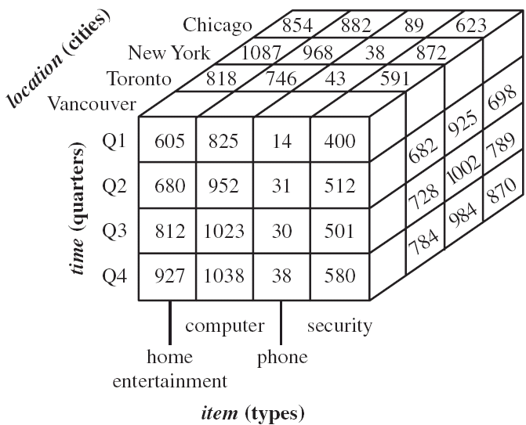
3D Data cube Example

Slide 28
Dimensionality Reduction
Feature selection (i.e., attribute subset selection):
Select a minimum set of features such that the probability distribution of different classes given the values for those features is as close as possible to the original distribution given the values of all features
reduce # of patterns in the patterns, easier to understand
Heuristic methods (due to exponential # of choices):
step-wise forward selection
step-wise backward elimination
combining forward selection and backward elimination
decision-tree induction

Slide 29
Example of Decision Tree Induction
Initial attribute set:
{A1, A2, A3, A4, A5, A6}
A4 ?
A1?
A6?
Class 1
Class 2
Class 1
Class 2
>
Reduced attribute set: {A1, A4, A6}

Slide 30
Data Compression
Original Data
Compressed
Data
lossless
Original Data
Approximated
lossy

Slide 31
Principal Component Analysis
Given N data vectors from k-dimensions, find c <= k orthogonal vectors that can be best used to represent data
The original data set is reduced to one consisting of N data vectors on c principal components (reduced dimensions)
Each data vector is a linear combination of the c principal component vectors
Works for numeric data only
Used when the number of dimensions is large

Slide 32
Principal Component Analysis
X2
Y1
Y2
X1, X2: original axes (attributes)
Y1,Y2: principal components
significant component (high variance)
X1
Order principal components by significance and eliminate weaker ones

Slide 33
Numerosity Reduction: Reduce the volume of data
Parametric methods
Assume the data fits some model, estimate model parameters, store only the parameters, and discard the data (except possible outliers)
Log-linear models: obtain value at a point in m-D space as the product on appropriate marginal subspaces
Non-parametric methods
Do not assume models
Major families: histograms, clustering, sampling

Slide 34
Histograms
A popular data reduction technique
Divide data into buckets and store average (or sum) for each bucket
Can be constructed optimally in one dimension using dynamic programming
Related to quantization problems.

Slide 35
Clustering
Partitions data set into clusters, and models it by one representative from each cluster
Can be very effective if data is clustered but not if data is “smeared”

Slide 36
Cluster Analysis
the distance between points in the same cluster should be small
salary
the distance between points in different clusters should be large
cluster
outlier
age

Slide 37
Discretization
Three types of attributes:
Nominal — values from an unordered set
Ordinal — values from an ordered set
Continuous — real numbers
Discretization:
divide the range of a continuous attribute into intervals
why?
Some classification algorithms only accept categorical attributes.
Reduce data size by discretization
Prepare for further analysis

Slide 38
Discretization and Concept hierachy
Discretization
reduce the number of values for a given continuous attribute by dividing the range of the attribute into intervals. Interval labels can then be used to replace actual data values.
Concept hierarchies
reduce the data by collecting and replacing low level concepts (such as numeric values for the attribute age) by higher level concepts (such as young, middle-aged, or senior).

Slide 39
Discretization and concept hierarchy generation for numeric data
Binning/Smoothing
Histogram analysis
Clustering analysis
Entropy-based discretization
Segmentation by natural partitioning

Slide 40
Entropy-Based Discretization
Given a set of samples S, if S is partitioned into two intervals S1 and S2 using boundary T, the information gain I(S,T) after partitioning is
Entropy:

Slide 41
Entropy-Based Discretization
The boundary that maximizes the information gain over all possible boundaries is selected as a binary discretization.
The process is recursively applied to partitions obtained until some stopping criterion is met, e.g.,
Experiments show that it may reduce data size and improve classification accuracy

Slide 42
Segmentation by natural partitioning
Users often like to see numerical ranges partitioned into relatively uniform, easy-to-read intervals that appear intuitive or “natural”. E.g., [50-60] better than [51.223-60.812]
The 3-4-5 rule can be used to segment numerical data into
relatively uniform, “natural” intervals.
* If an interval covers 3, 6, 7 or 9 distinct values at the most significant digit, partition the range into 3 equiwidth intervals for 3,6,9 or 2-3-2 for 7
* If it covers 2, 4, or 8 distinct values at the most significant digit, partition the range into 4 equiwidth intervals
* If it covers 1, 5, or 10 distinct values at the most significant digit, partition the range into 5 equiwidth intervals
The rule can be recursively applied for the resulting intervals

Slide 43
Conceapt hierarchy generation
Concept hierarchy can be automatically generated based on the number of distinct values per attribute in the given attribute set. The attribute with the most distinct values is placed at the lowest level of the hierarchy.
country
15 distinct values
province_or_ state
65 distinct values
city
3567 distinct values
street
674,339 distinct values

Slide 44
Terima Kasih
Ada Pertanyaan…???

